Slide 1
Mini project: Description of 60 kV voltage transformer and assessment of the insulation quality.

Slide 2
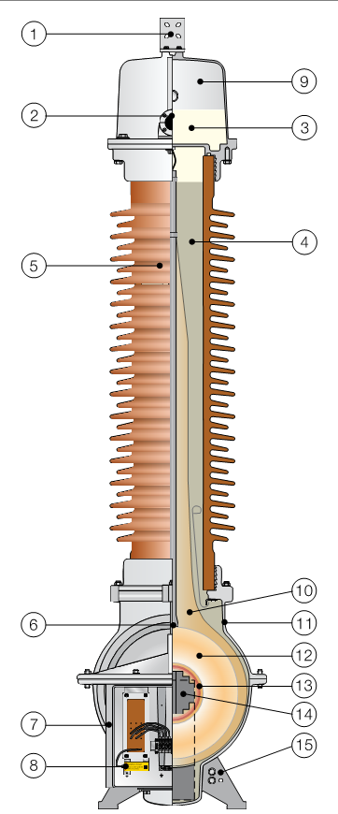
Detailed description of voltage transformer including rated data and description of dielectric design
1 | Primary terminal
2 | Oil level sight glass
3 | Oil
4 | Quartz filling
5 | Insulator
6 | Lifting lug
7 | Secondary terminal box
8 | Neutral end terminal
9 | Expansion system
10 | Paper insulation
11 | Tank
12 | Primary winding
13 | Secondary windings
14 | Core
15 | Ground connection
Notes:
The ABB Inductive Voltage Transformer EMF (EMF 52-170) is a voltage transformer which is made for connection between a phase and ground, when the network is either insulated or direct-grounded natural point [1].
The standard design of the EMF 52-170 has three windings, a primary, secondary and tertiary winding. The tertiary is normally for measuring ground faults, but other configurations can be made available if required. All the windings are design with double enameled wire and are insulated from the core. The isolation material for the primary winding is paper. Furthermore, the cores of the EMF 52-170 is made of materials which ensures a flat magnetization curve and the core of the EMF 52-170 is also over-dimensioned to keep a very low flux when operating at operating voltage [1].
All EMF’s from ABB has a paper-quartz-oil isolating.

Slide 3
Detailed description of voltage transformer including rated data and description of dielectric design

Slide 4

Measure transfer ratio full range
Voltage equation for ideal transformer
$$\frac{V_{1}}{V_{2}}=\frac{N_{1}}{N_{2}}=n$$
Current equation for ideal transformer
$$I_{1}N_{1}=I_{2}N_{2}$$
Assuming small losses.
Measuring no-load
Voltage drop can be ignored
$$V_{1}=\frac{N_{1}}{N_{2}}V_{2}−∆V$$
Theoretical ratio
$$\frac{V_{1}}{V_{2}}=\frac{\frac{60000}{\sqrt{3}}}{\frac{110}{\sqrt{3}}}=545$$
a1-n1 |  | a2-n2 |  | da-dn
Primary side [V] | Secondary side [V] | Primary side [V] | Secondary side [V] | Primary side [V] | Secondary side [V]
10.410 | 19,28 | 10.420 | 19,32 | 10.400 | 19,84
20.056 | 36,95 | 20.100 | 37,05 | 20.120 | 38,03
29.990 | 54,64 | 30.150 | 54,82 | 30.100 | 56,26
40.200 | 73,3 | 40.190 | 73,18 | 40.700 | 75,9
 | a1-n1 | a2-n2 | ad-nd
Meas 1 | 540 | 539 | 524
Meas 2 | 543 | 543 | 529
Meas 3 | 549 | 550 | 535
Meas 4 | 548 | 549 | 536
Mean | 545 | 545 | 531

Slide 5
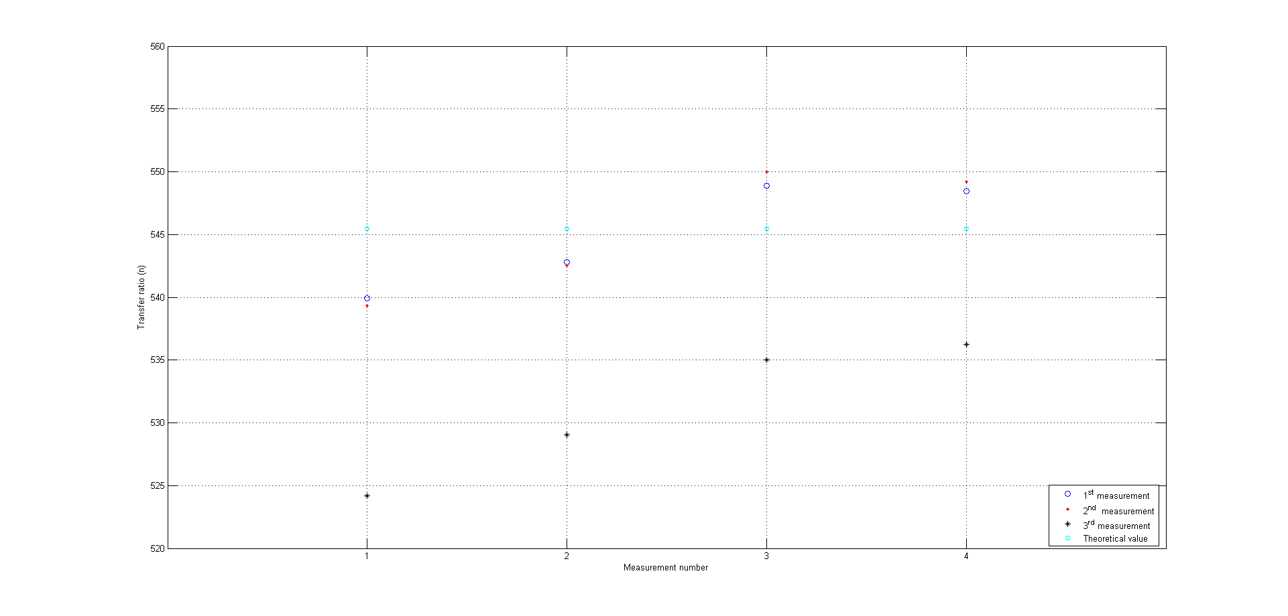
Measure transfer ratio full range
Notes:
Theoretical value

Slide 6
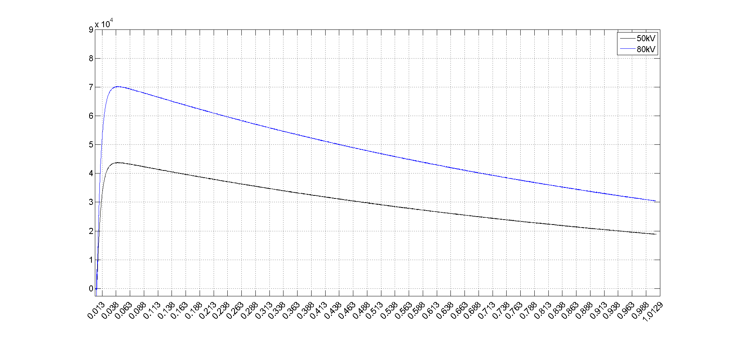
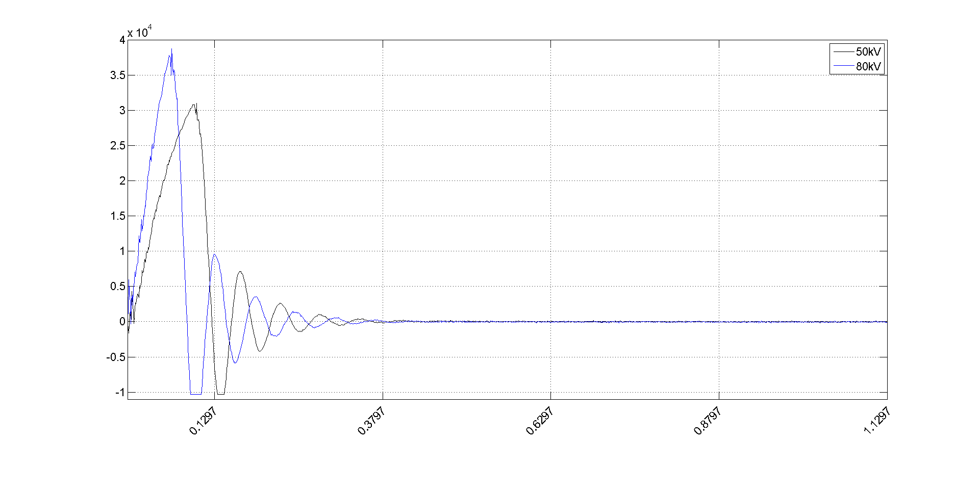
Power frequency and lightning overvoltage test
Impuls voltage generator circuits
Notes:
R1: front damping res
R2: Discharge
C1: Discharge
0,3 ½

Slide 7
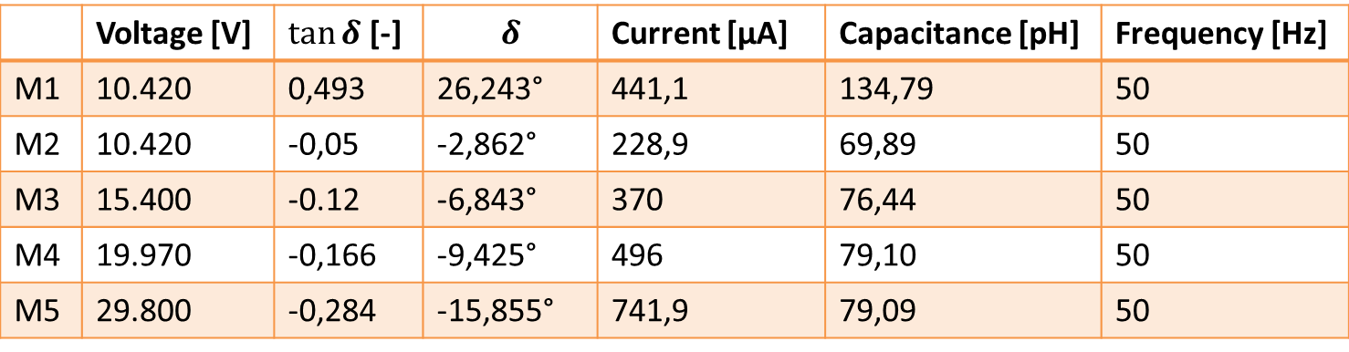
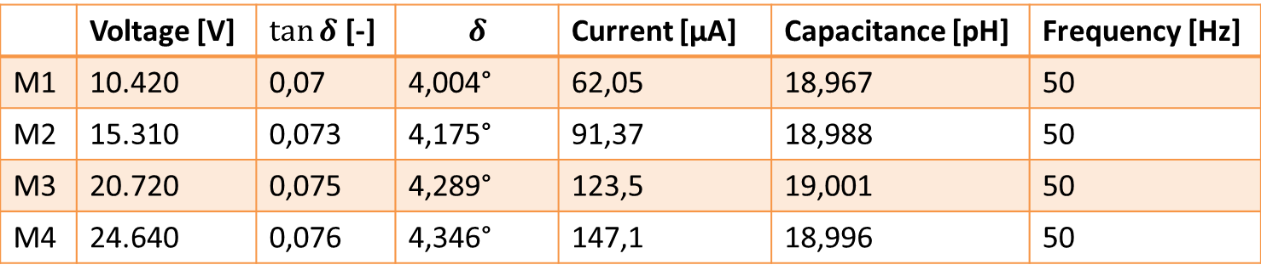
Dielectric loss angle measurement
 | Voltage [V] | $\tan{δ}$ [-] | $$δ$$ | Current [µA] | Capacitance [pH] | Frequency [Hz]
M1 | 10.420 | 0,493 | 26,243° | 441,1 | 134,79 | 50
M2 | 10.420 | -0,05 | -2,862° | 228,9 | 69,89 | 50
M3 | 15.400 | -0.12 | -6,843° | 370 | 76,44 | 50
M4 | 19.970 | -0,166 | -9,425° | 496 | 79,10 | 50
M5 | 29.800 | -0,284 | -15,855° | 741,9 | 79,09 | 50
 | Voltage [V] | $\tan{δ}$ [-] | $$δ$$ | Current [µA] | Capacitance [pH] | Frequency [Hz]
M1 | 10.420 | 0,07 | 4,004° | 62,05 | 18,967 | 50
M2 | 15.310 | 0,073 | 4,175° | 91,37 | 18,988 | 50
M3 | 20.720 | 0,075 | 4,289° | 123,5 | 19,001 | 50
M4 | 24.640 | 0,076 | 4,346° | 147,1 | 18,996 | 50
Notes:
The reason for this test is to test the qulaty of the insolation.

Slide 8
Dielectric loss angle measurement
Notes:
Null dector O must show zero

Slide 9
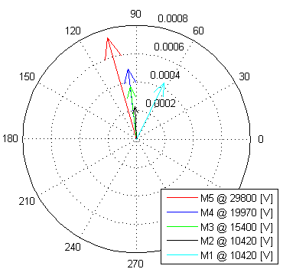
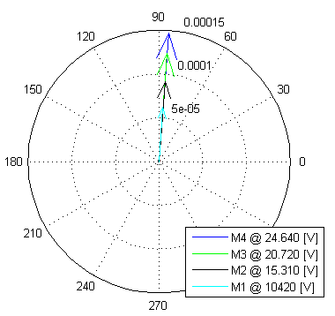
Dielectric loss angle measurement
Notes:
Insæt circut

Slide 10
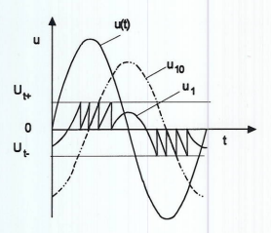
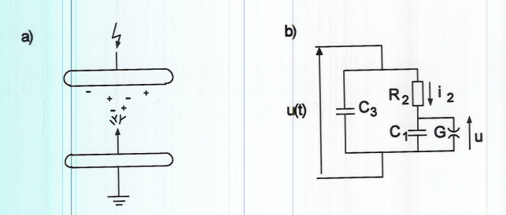
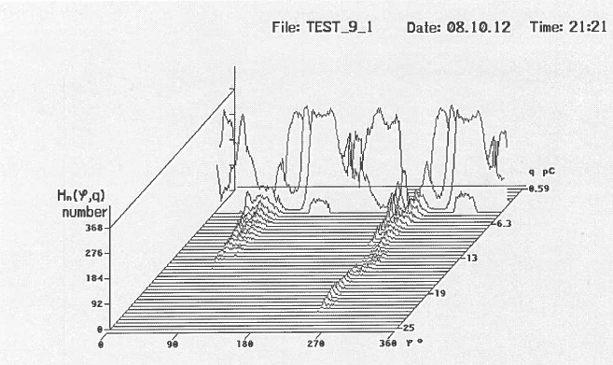
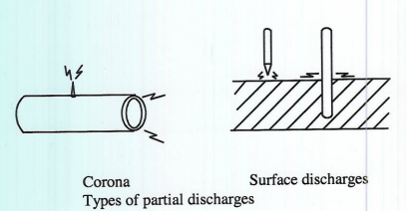
Partial discharge measurement
Notes:
Insæt circut

Slide 11
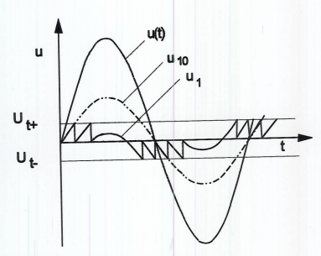
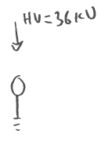
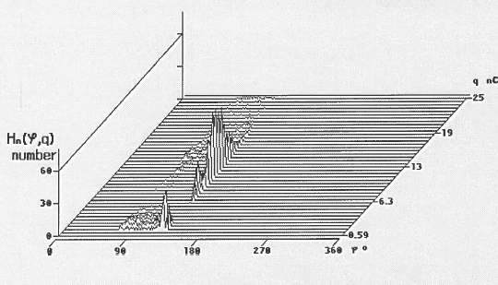
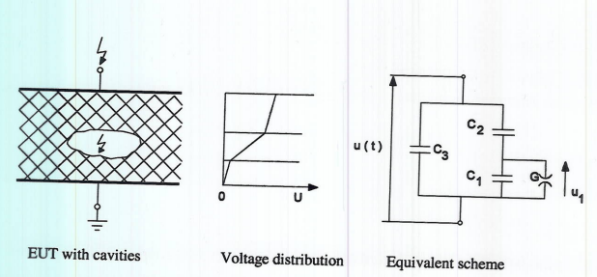
Partial discharge measurement
Notes:
Insæt circut

Slide 12
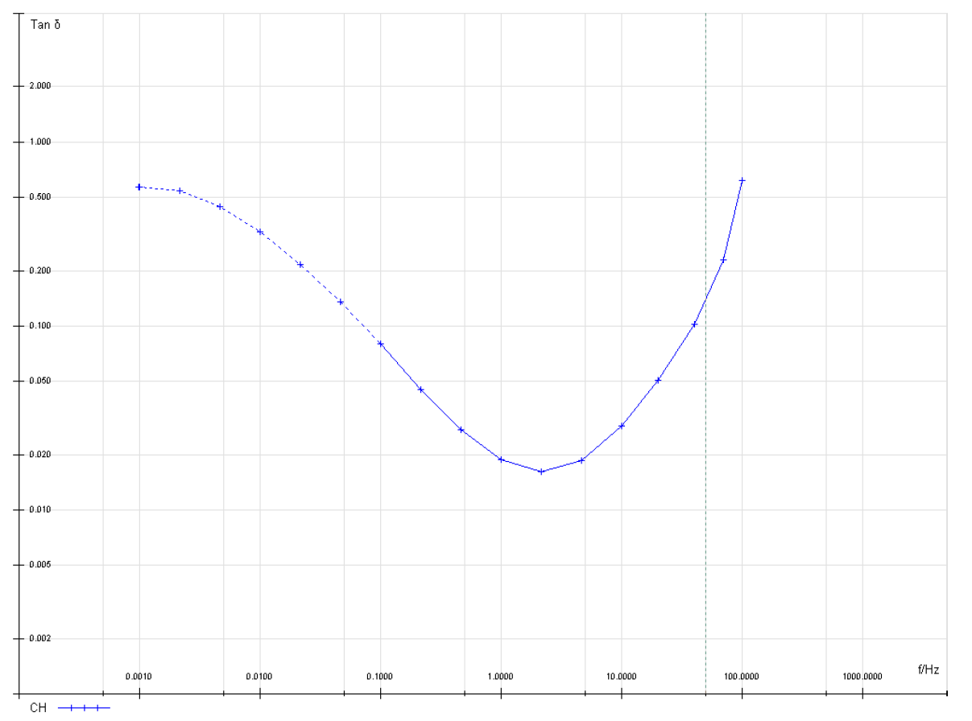
Dielectric spectroscopy test
Notes:
Insæt circut

Slide 13
Conclusions, assessment of lifetime

